Slide 1
How do machines learn?
Dr. Erdi Kara

Slide 2
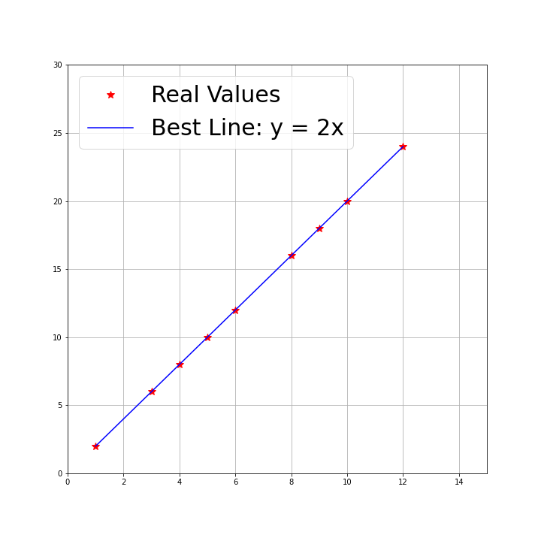
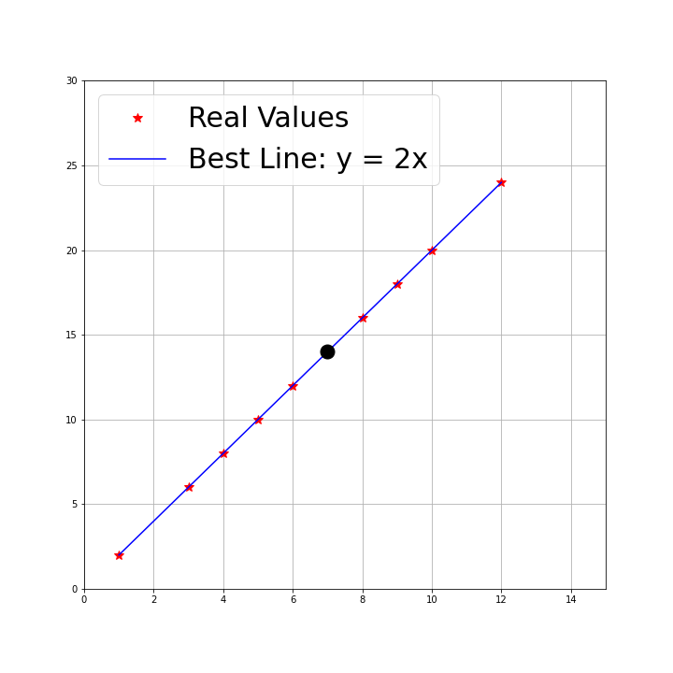
x: [ 1 3 4 5 6 8 9 10 12]
y :[ 2 6 8 10 12 16 18 20 24]
What is the relationship? If x=7, what is y = ?

Slide 3
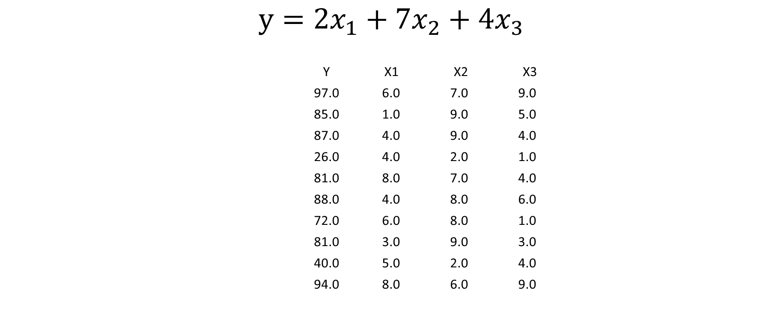
How about the following data
$$y=2x_{1}+{7x}_{2}+{4x}_{3}$$
Y X1 X2 X3
97.0 6.0 7.0 9.0
85.0 1.0 9.0 5.0
87.0 4.0 9.0 4.0
26.0 4.0 2.0 1.0
81.0 8.0 7.0 4.0
88.0 4.0 8.0 6.0
72.0 6.0 8.0 1.0
81.0 3.0 9.0 3.0
40.0 5.0 2.0 4.0
94.0 8.0 6.0 9.0

Slide 4
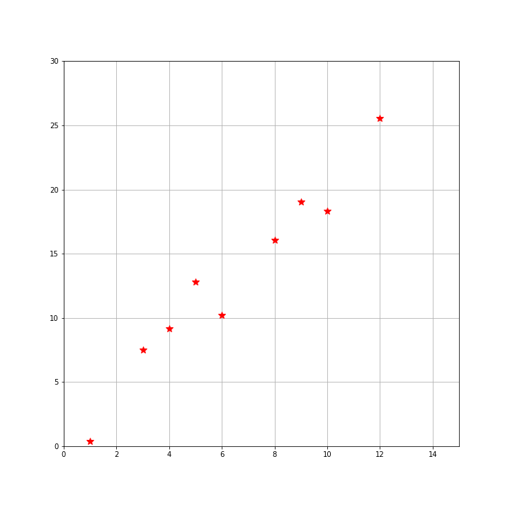
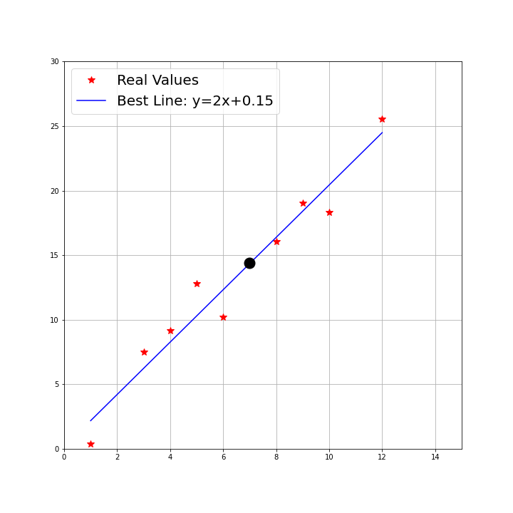
x: [ 1 3 4 5 6 8 9 10 12]
y :[ 0.4 7.5 9.2 12.8 10.2 16.1 19. 18.3 25.6]

Slide 5
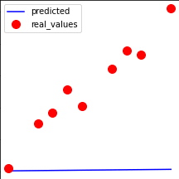
How did the algorithm learn that line?

Slide 6
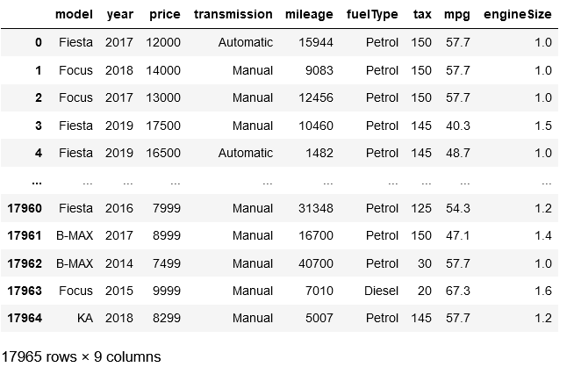
Can you predict the price?

Slide 7
General Framework
Data
Training
Testing
Prediction

Slide 8
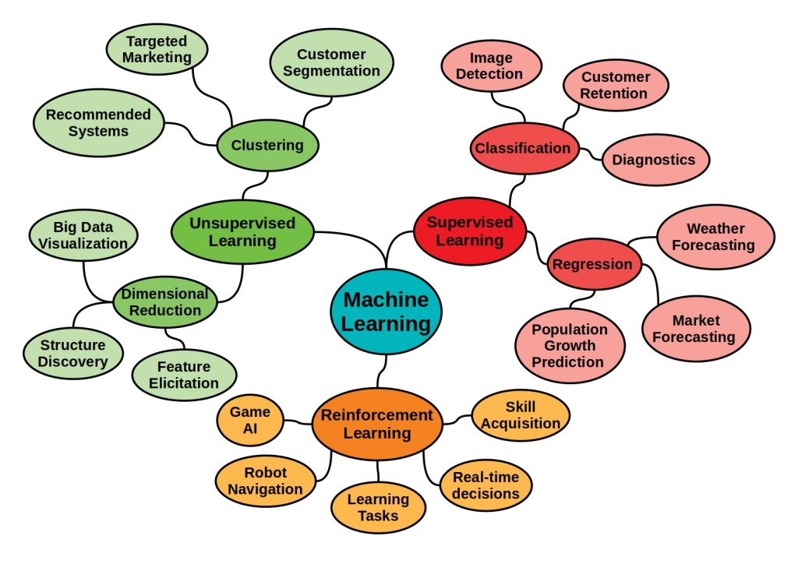

Slide 9
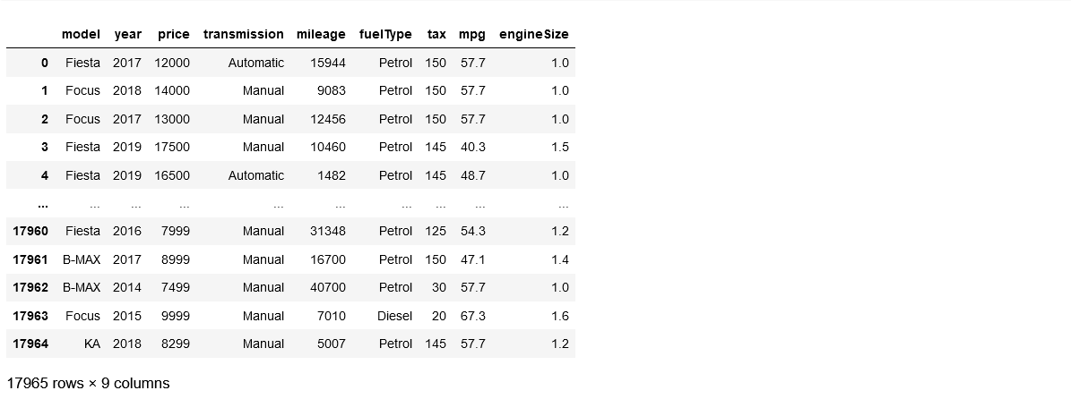
Supervised Learning - Regression

Slide 10
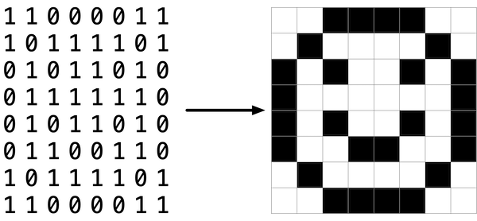
What is an image?

Slide 11
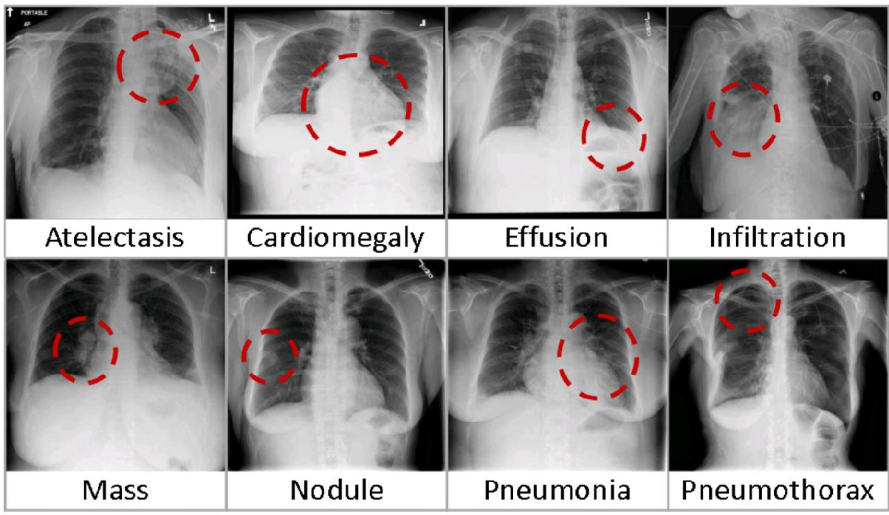
Supervised Learning - Classification

Slide 12
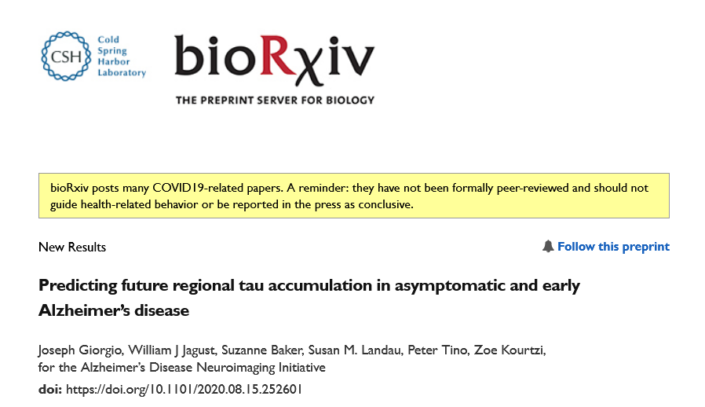
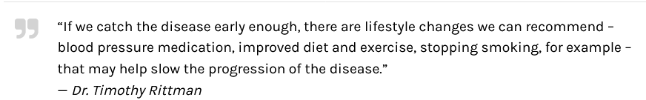
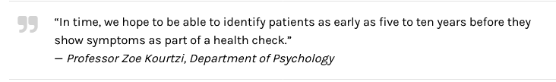

Slide 13
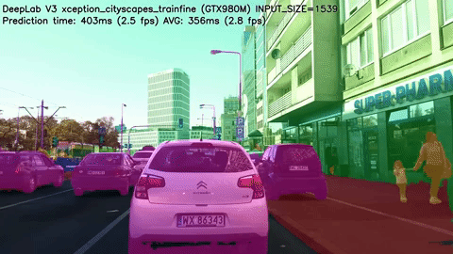
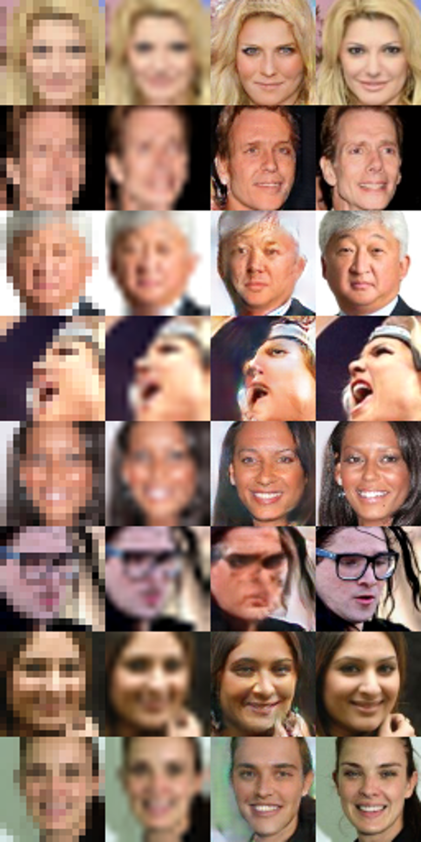

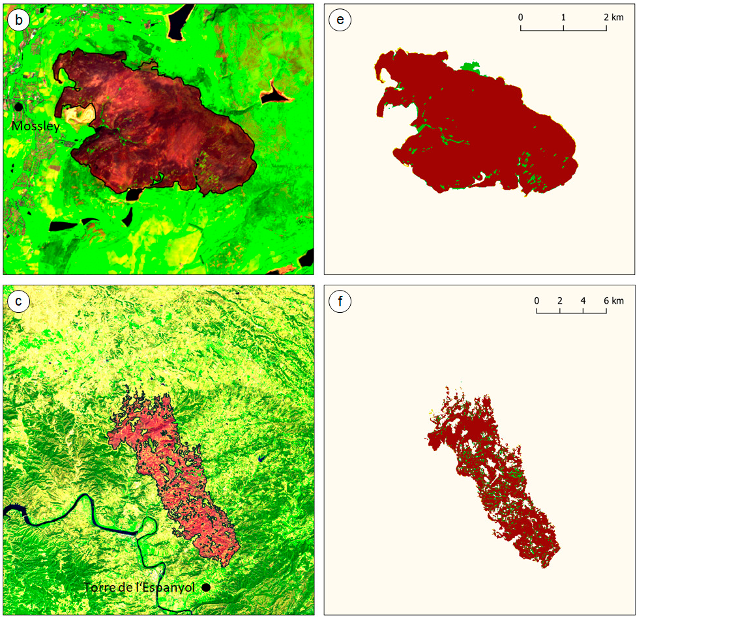

Slide 14
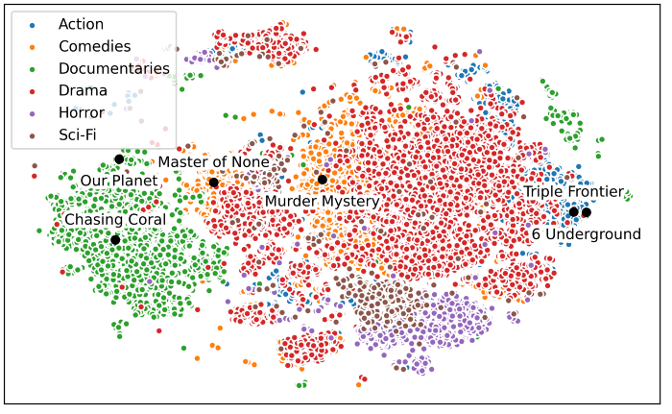
Unsupervised Learning - Classification

Slide 15
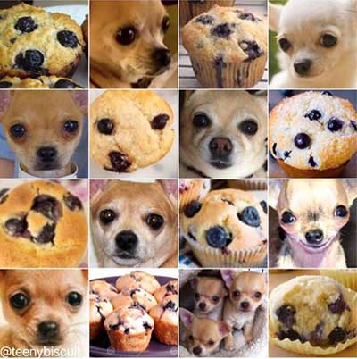
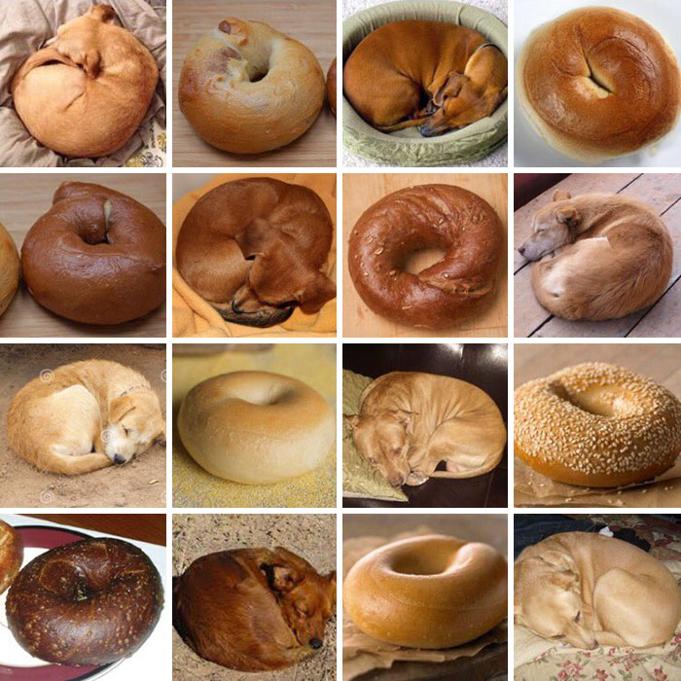
Limitations!

Slide 16
Where to start
Youtube is #1 source for introductory concepts. Few tutorials are here 1, 2, 3.
Calculus, Linear Algebra and some Statistics !
Start Python. Here is #1 tutorial series.
Grab a project and work on it.

